Slide 1
Introduction to Service Meshes
Marvin Bertram, Richard Bischof, Kevin Schulze
Notes:
Marvin

Slide 2
Agenda
Chapter 1 Chapter 2 Chapter 3 Chapter 4 Chapter 5 | Introduction and motivation of service meshes Fundamentals Istio: Architecture Istio: Use cases Example Demo Conclusion | Seite x Seite y
Notes:
Marvin

Slide 3
Chapter 1: Introduction
Cloud Computing
5 characteristica - 4 deployment models - 3 service models
enabling everyone to provide high quality services
Agile Manifesto
4 principles of values in agile work
shift of mind from “never change a running system” to “fail fast, fail often”
Transition from monoliths to microservices
“big ball of mud” [Foote,1999]
systems should consist of loosely coupled services
Domain-Driven-Design
Notes:
Richard
What is the problem service-meshes are the solution for?

Slide 4
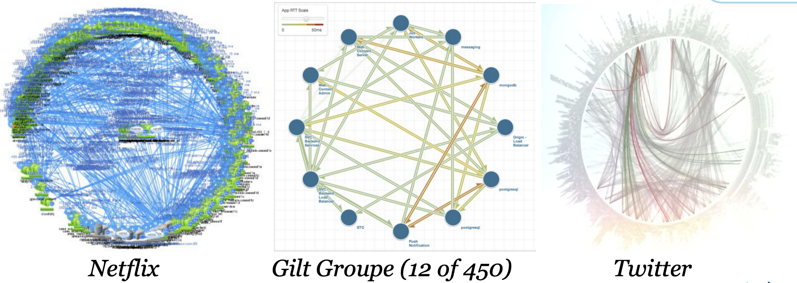
Chapter 1: Motivation
“Death-Star of Microservices”
[Cockcroft 2014]
Why should the infrastructure be extracted from applications?
collaborative development and reusability of artefacts
save and reliable deployments
change of infrastructure without change of application
Notes:
Richard

Slide 5
Chapter 2: Fundamentals: Services-Meshes
Service Meshes: dedicated infrastructure component
observing, controlling and securing communication between applications
earlier approaches: ESB, API Gateways
only focuses on networking rather than business concerns
Service Mesh Interface (SMI): standard developed by Microsoft, HashiCorp, Buoyant, Solo.io
Application
Application
Service-Mesh
Orchestration
Orchestration
Infrastructure
Infrastructure
Notes:
Richard

Slide 6
Chapter 2: Fundamentals: Sidecar-Pattern
One Pattern of distributed systems
Application
contains application
focuses on domain
Sidecar
extends functionality by establishing single point of communication to application
Application
Sidecar
deployment unit
Notes:
Richard

Slide 7


Chapter 2: Fundamentals: Kubernetes
Runtime: Docker-Container
immutable application artefacts
containers
Orchestration: Kubernetes
Pods
one or more containers
Deployments
controller for pods and replica-sets
Services
exposes pod-services through the cluster (DNS, NodePort, LoadBalancer)
Custom Resource Definitions (CRD) z. B. VirtualService, DestinationRule
Notes:
Richard

Slide 8
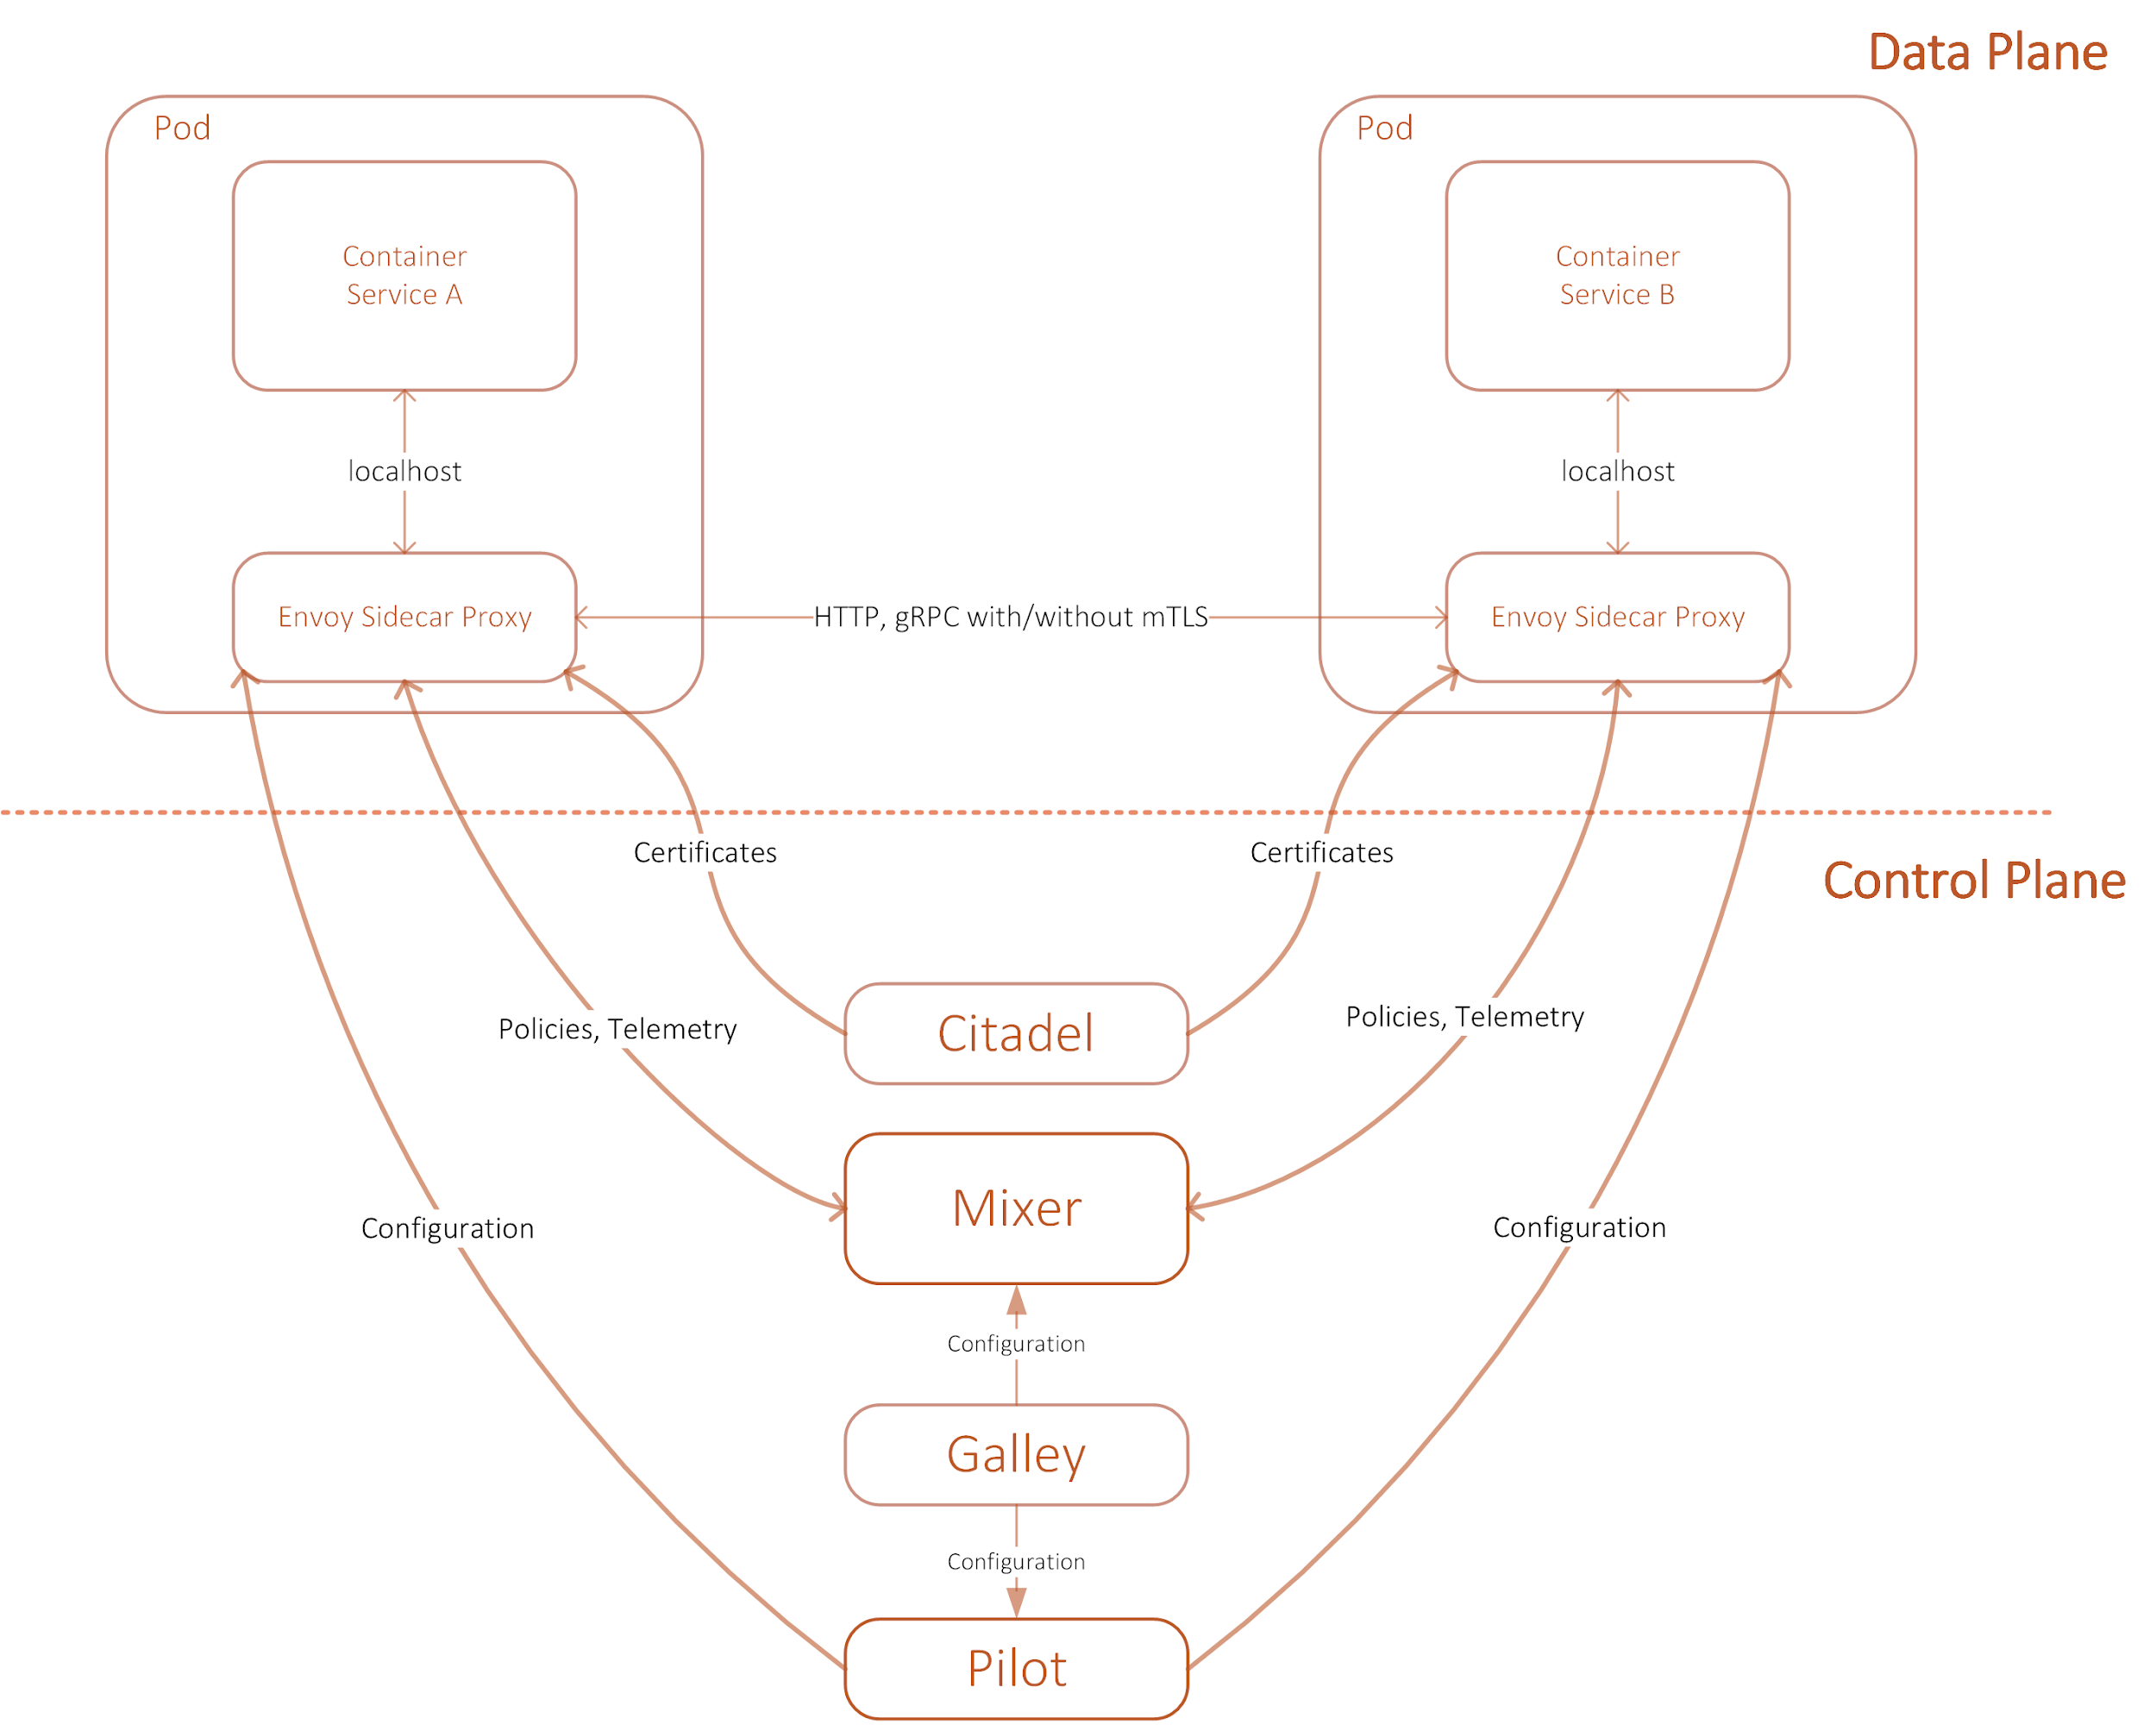
Chapter 3: Istio Architecture
After: https://istio.io/docs/ops/deployment/architecture/arch.svg
Notes:
Marvin Minute 5

Slide 9

Chapter 3: Use Case: Security
[Istio, 2019]
mTLS encryption between the services
Authentication
Service-to-service
End-user to service
Different identity providers
Authorization
Policies can be applied to namespaces, services, mesh
Define invocation path: service A → service B → service C
Role-based access control
Audit
Who called which service at what time?
Source: https://archive.istio.io/v1.0/docs/concepts/security/
Notes:
Marvin
Zero trust inside the mesh
Restrict access for a particular user or device
Attribut für User wird im Request gesetzt
JWT: JSON web tokens
OAuth Protokoll und OpenID Connect

Slide 10
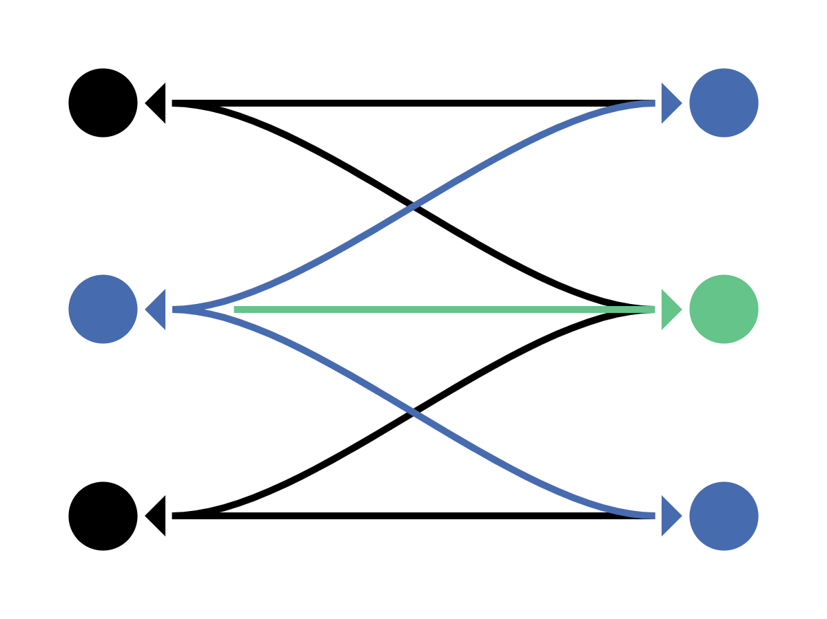
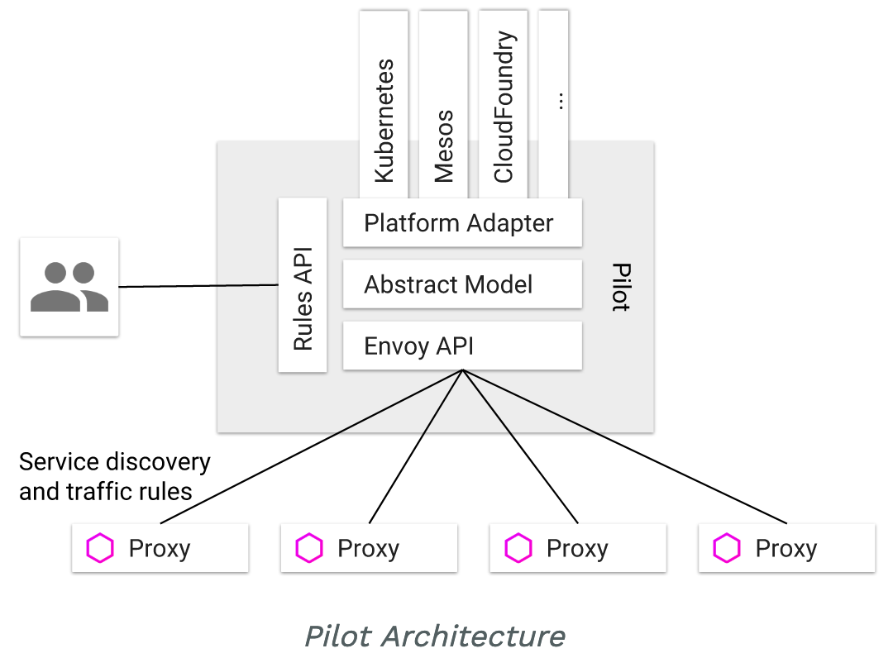
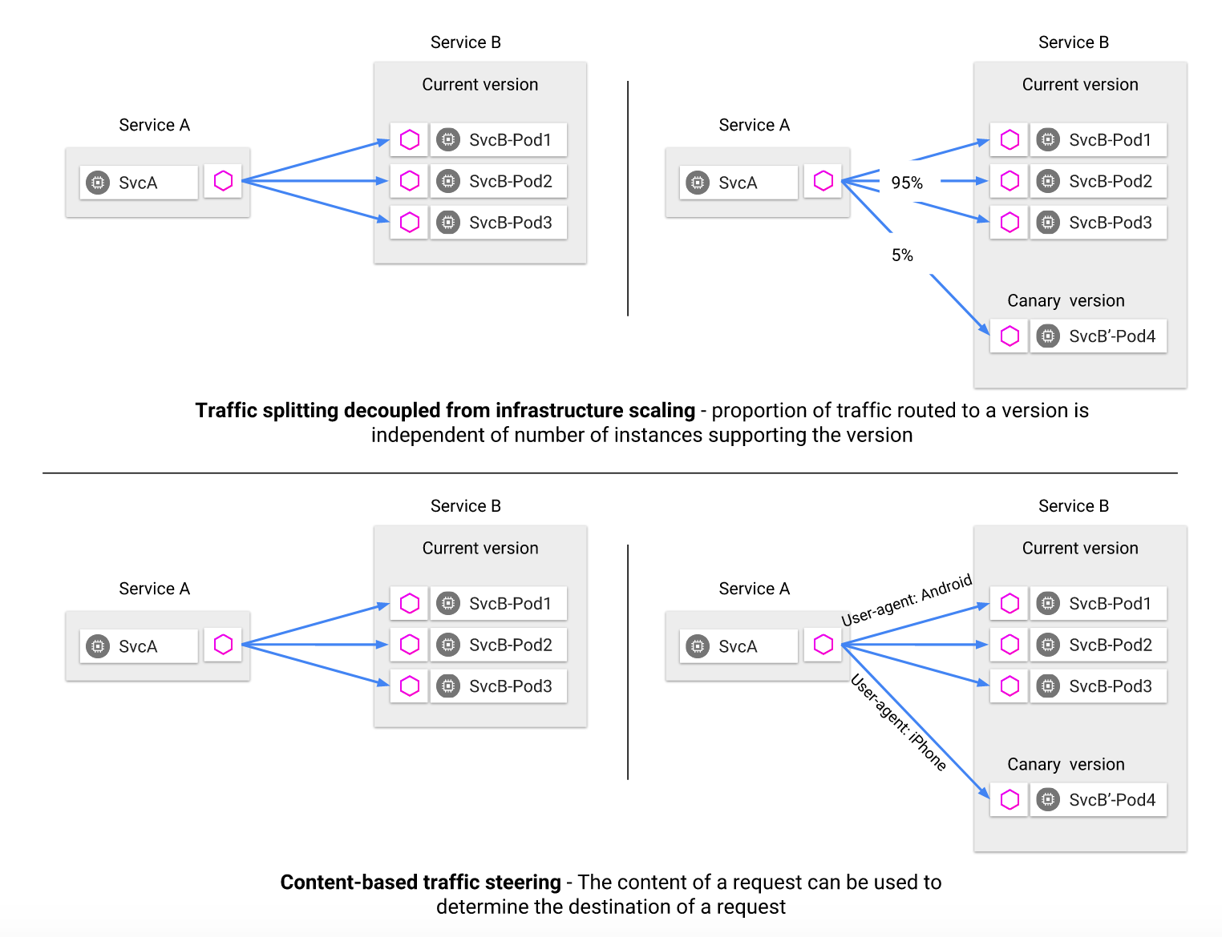
Chapter 3: Use Case: Traffic Management
Traffic rules specified via Pilot
Traffic management features:
A/B testing
Gradual rollouts
handles failure recovery using:
timeouts
retries
circuit breakers
fault injection
Realized through the sidecars deployed across the service mesh
Source: https://archive.istio.io/v1.0/docs/concepts/traffic-management/
Notes:
Kevin
Rules API:
Plattform Adapter:
Abstract Model: hides all the plattform specific stuff from user
Envoy API: Interface for Communication with other Sidecars/Proxys
Content-based traffic steering - The content of a request can be used to determine the destination of a request
much more: load balancing, periodic health checks

Slide 11
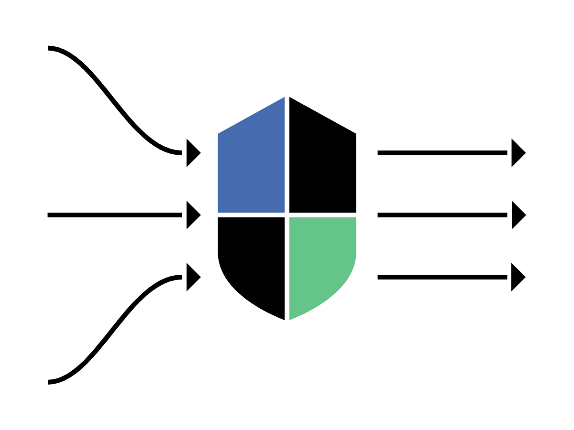
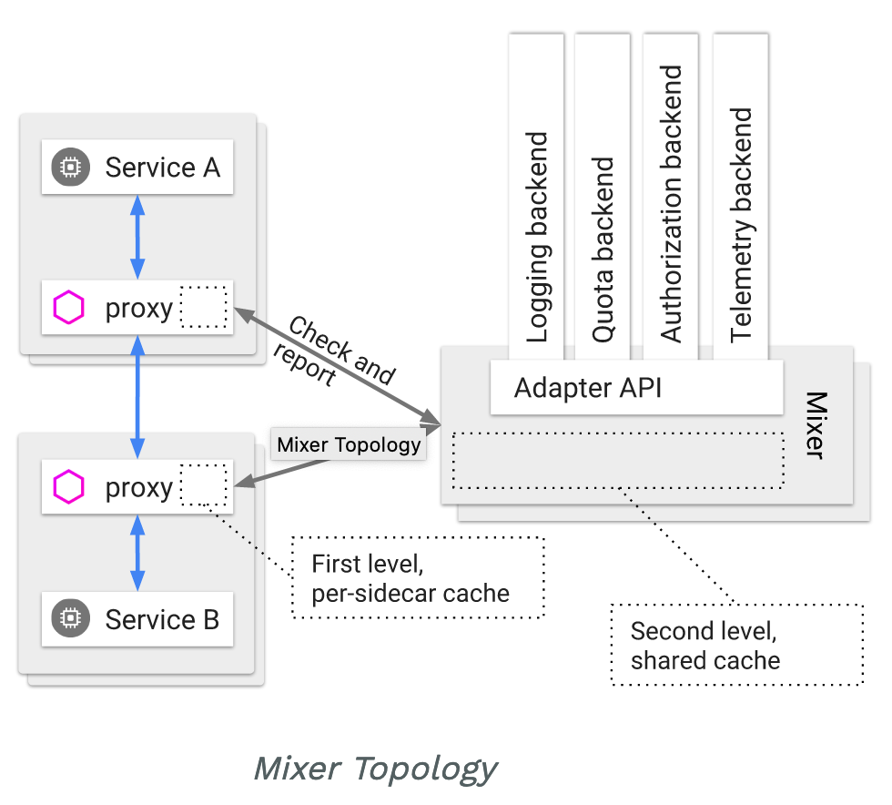
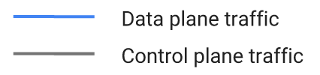
Chapter 3: Use Case: Policies & Telemetry
[Istio, 2019]
Mixer is responsible for providing policy controls and telemetry collection
The sidecar calls Mixer before each request to perform precondition checks, and after each request to report telemetry
Sidecar has local caching and buffers telemetry
Source: https://archive.istio.io/v1.0/docs/concepts/policies-and-telemetry/
Notes:
Kevin
Sidecar has local caching
precondition checks can be performed from cache
Sidecar buffers outgoing telemetry
calls Mixer infrequently

Slide 12
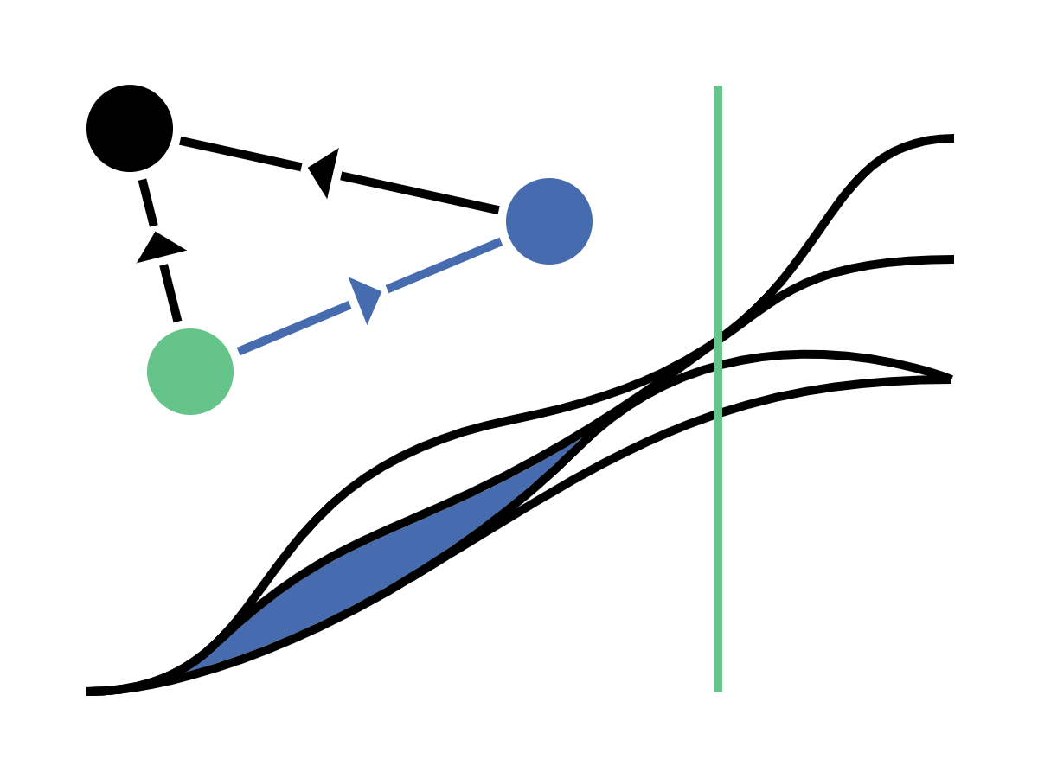
Chapter 3: Use Case: Observability
Tracing
Determine which microservices are used in a request and their dependencies
Flow through the mesh
Different tracing backends supported:
Jaeger, LightStep, Zipkin
Default is Envoy
Metrics
Inbound, outbound and inside the mesh
Error rates, response times, traffic volume, ...
Proxy-level, service-level, control-plane metrics
Service Graph
Visualizing and monitoring of the service mesh
[Istio, 2019]
Notes:
Kevin
Main reason why people choose a service mesh → they want to know whats going on

Slide 13
Chapter 4: Istio: Bookinfo-Application
Details
Reviews-v1
Envoy
productpage
Ruby
Envoy
Request
Ratings
Reviews-v2
Envoy
Python
Envoy
Envoy
NodeJs
Ingress Envoy
Reviews-v3
Envoy
Java
Source: https://istio.io/docs/examples/bookinfo/noistio.svg
Notes:
Kevin

Slide 14
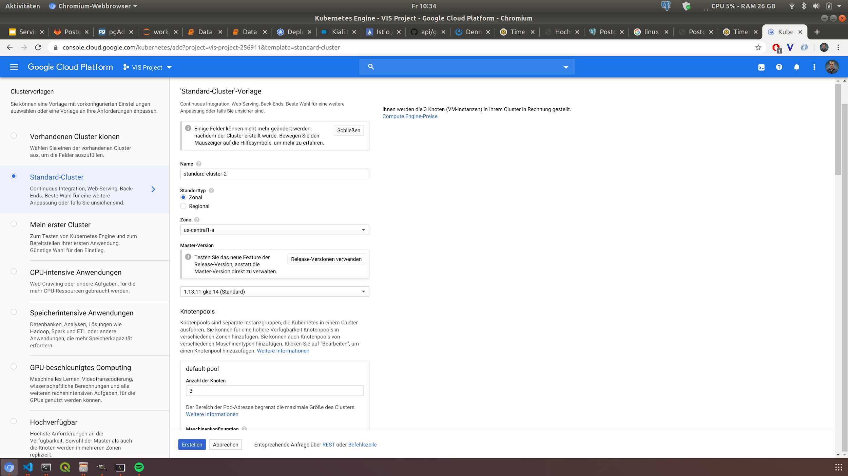

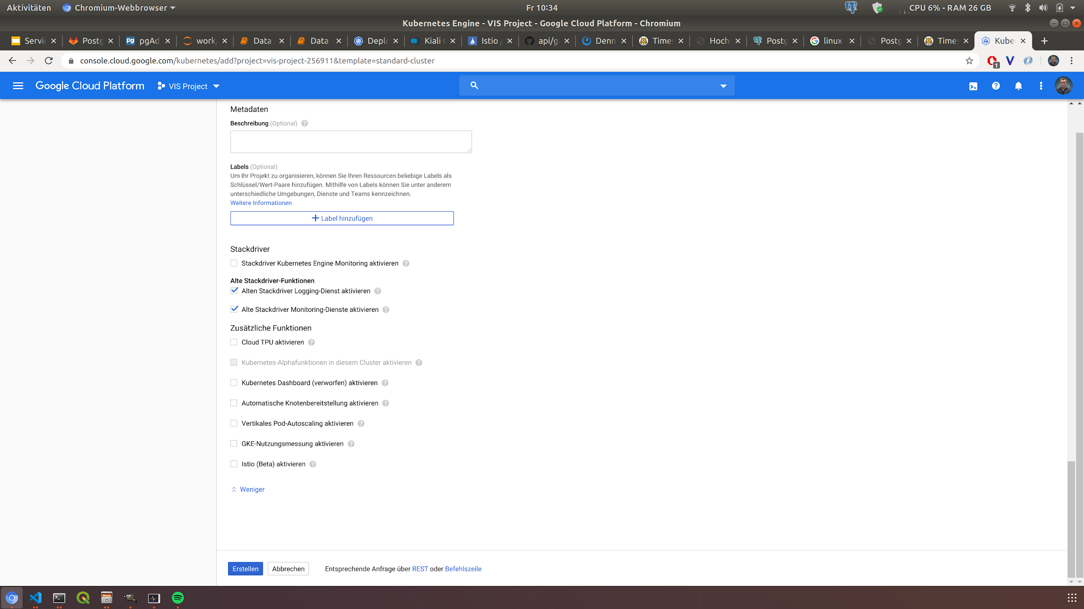
Chapter 4: Istio: Bookinfo-Application
Deployment
Google Kubernetes Engine
Kubernetes Version 1.13.11
4 Node Cluster
Automatic Istio Integration
$ kubectl get nodes
$ kubectl get namespaces
$ kubectl get all -n istio-system
$ kubectl get all -n default
Notes:
Richard
Isitio already installed on GKE
kubectl get pods
kubectl get pods -n istio-system
kubectl get svc
kubectl get svc -n istio-system
Weglassen wenn Zeitmangel

Slide 15
Chapter 4: Istio: Bookinfo-Application
Observability with Kiali Demo
Topology visualization of the mesh
Different views of metrics and services
Monitoring of the service mesh
Limited configuration of Istio
Validation
Jaeger¹ tracing included
$ istioctl dashboard kiali
¹https://www.jaegertracing.io/docs/1.9/
Notes:
Marvin

Slide 16

Chapter 4: Istio: Bookinfo-Application
Demo
http://34.69.155.52/productpage

Slide 17
Chapter 4: Istio: Bookinfo-Application
Traffic Routing Demo
Route traffic from iOS users to reviews v1 page
Route traffic from Android users to reviews v2 page
Route traffic from Windows users to reviews v3 page
All other traffic goes to version 1 of the reviews page
Destination Rule
Subsets
Virtual Service
Traffic Routing
Notes:
Marvin

Slide 18
Chapter 4: Istio: Bookinfo-Application
Traffic Routing Demo
Destination Rule
Virtual Service
kind: DestinationRule
metadata:
name: dr-reviews
spec:
host: reviews
subsets:
- labels:
version: v1
name: version-v1
- labels:
version: v2
name: version-v2
- labels:
version: v3
name: version-v3
kind: VirtualService
metadata:
name: reviews-virtualservice
spec:
hosts:
- reviews
http:
- match:
- headers:
user-agent:
regex: .*iPhone.*
route:
- destination:
host: reviews
subset: version-v1
- match:
- headers:
user-agent:
regex: .*Android.*
Notes:
Marvin

Slide 19
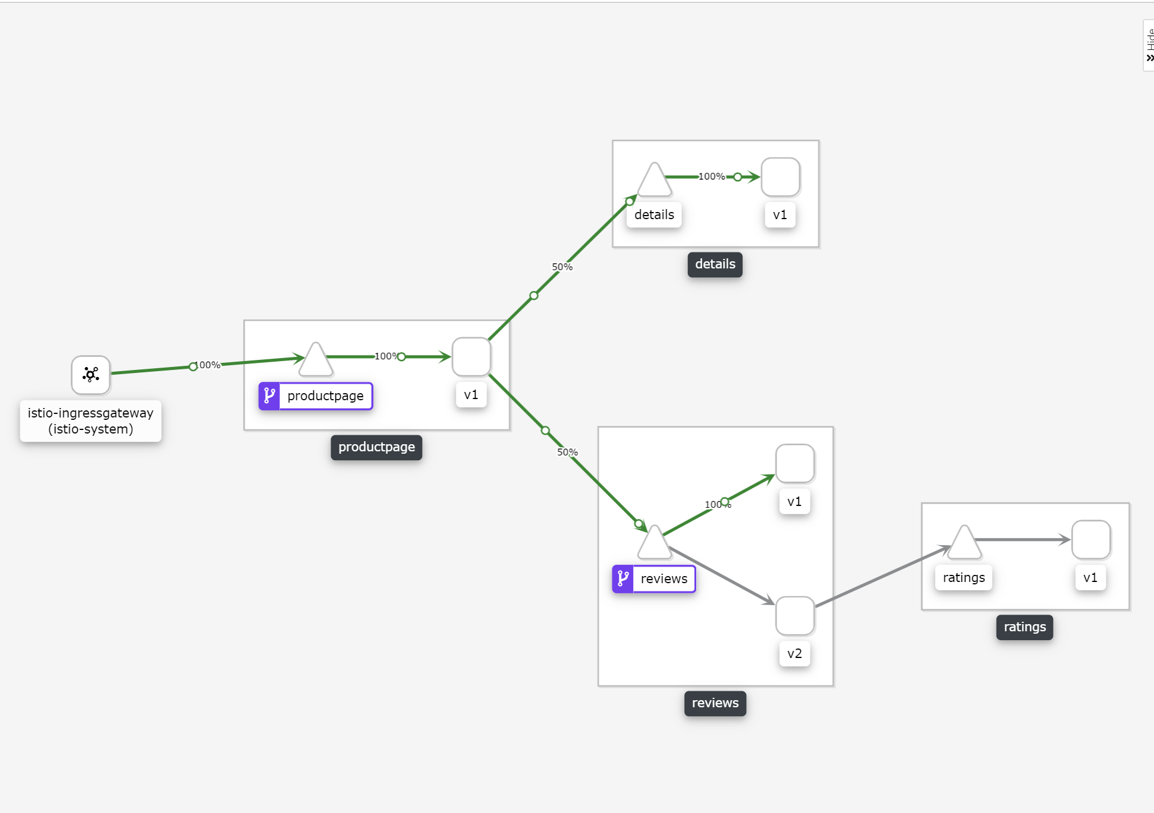
Chapter 4: Istio: Bookinfo-Application
Observability with Kiali Demo
Notes:
marvin
Falls irgendwas nicht funktioniert

Slide 20

Chapter 5: Conclusion
Pros | Cons
simplifies application architecture | higher overall complexity
decoupling application from infrastructure code | Adding extra hop for communication
development focuses on domain weather deployment environment | useful only in high automated environments
consistency across all microservices
→ The concept of services meshes can be beneficial for microservice architectures
→ Nevertheless requirements and use cases should also taken into account
Notes:
Kevin
We’ve taken a quick look on services meshes. After going through the fundamentals and basic idea, we focused on Istio and gave an overview for its use cases with the bookinfo-application.
→ We expect todays products will keep changing
After all Pros: A team of experts can take care of the tasks, otherwise every developer has to do these tasks
Cons
Complexity: Having a service mesh drastically increase the number of runtime instances that you have in a given microservice implementation.
Adding extra hops: Each service call has to go through an extra hop(through service mesh sidecar proxy).
Service Meshes address a subset of problems: Service mesh only address a subset of inter-service communication problems, but there are a lot of complex problems such as complex routing, transformation/type mapping, integrating with other services and systems, to be solved at your microservice’s business logic.
Immature: Service mesh technologies are relatively new to be declared as full production ready for large-scale deployments.

Slide 21
Thank you for your attention!

Slide 22
References
[Burns, 2018] Brendan Burns: “Designing Distributed Systems: Patterns and Paradigms for Scalable, Reliable Services” O’Reilly 2018
[Wolff, 2018] https://www.heise.de/developer/artikel/Microservices-Oder-lieber-Monolithen-3944829.html
[Intro to Istio] Sutter, B. and Posta, C., “Introducing Istio Service Mesh for Microservices”, O'Reilly Media 2019
[Foote et. al. 1999] Big Ball of Mud, Department of Computer Science, University of Illinois
[Istio, 2019] https://istio.io/
[Kiali] https://kiali.io/
[Cockroft,2014] https://gotocon.com/dl/goto-berlin-2014/slides/AdrianCockcroft_MigratingToCloudNativeWithMicroservices.pdf

